Slide 1
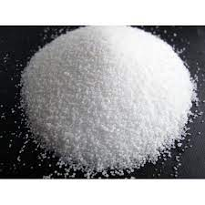
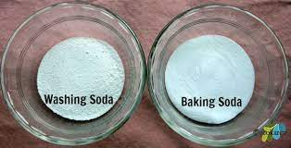
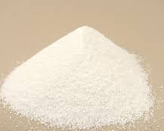
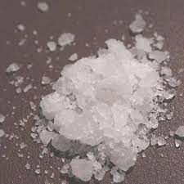
Caustic Soda
Table Salt
Soda Ash
Na₂CO₃.10H₂O
Na₂CO₃
NaHCO₃
NaOH
NaCl

Slide 2
Be(SO₄)
V
Mg(SO₄)
V
Ca(SO₄)
V
Sr(SO₄)
V
Ba(SO₄)
Be(OH)₂
ᴧ
Mg(OH)₂
ᴧ
Ca(OH)₂
ᴧ
Sr(OH)₂
ᴧ
Ba(OH)₂
Soluble
Insoluble
Insoluble
Soluble

Slide 3
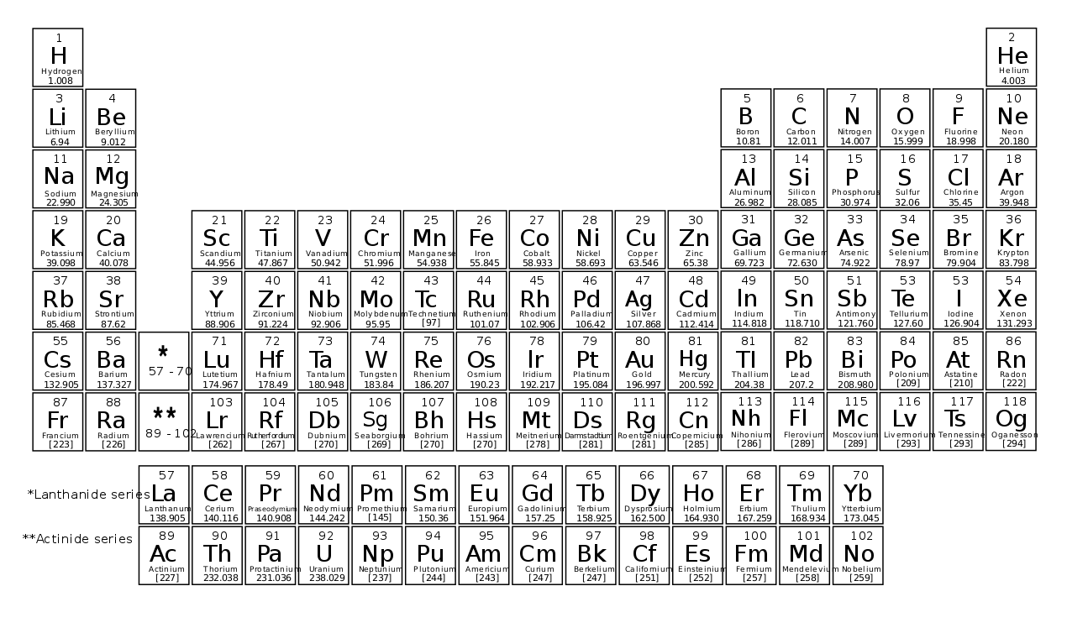

Slide 4
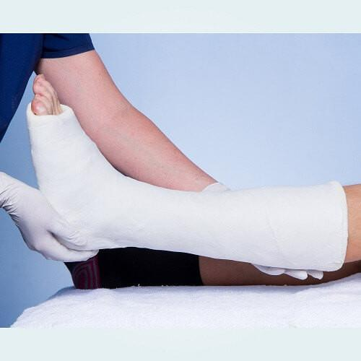
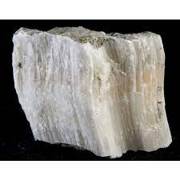
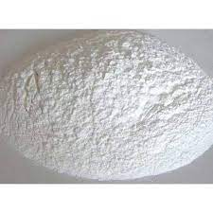
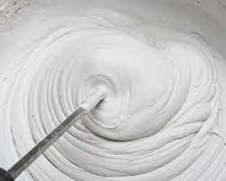
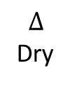
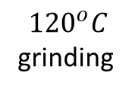
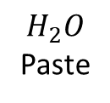

Gypsum
Plaster of Paris
Gypsum
$${120}^{o}C$$
grinding
$$H_{2}O$$
Paste
$$∆$$
Dry
CaCO₃.2H₂O
CaCO₃.$\frac{1}{2}$H₂O
CaCO₃ (aq)
CaCO₃.2H₂O

